Slide 1
Game Theory

Slide 2
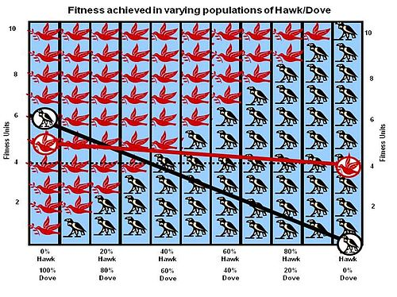
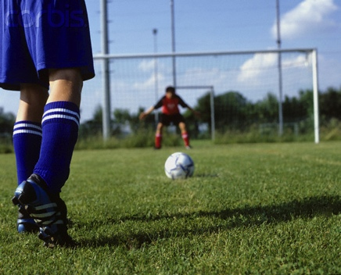

Applications
Voting
Sports
Bidding
Biology
Etc.

Slide 3
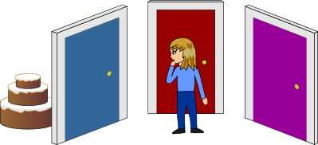
Main Aspects
Players
Action set = Choices
Utility = Payoffs

Slide 4
Action 1 | -1
Action 2 | 6

Slide 5
The Classic Game – Prisoner’s Dilemma
 | Cooperate | Defect
Cooperate | -1, -1 | -10, 0
Defect | 0, -10 | -5, -5

Slide 6
Assumptions in Basic Games
No sense of time.
Known game

Slide 7
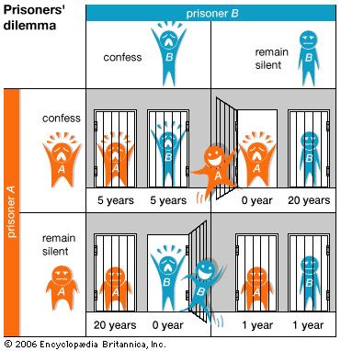
Many types of games
\\

Slide 8
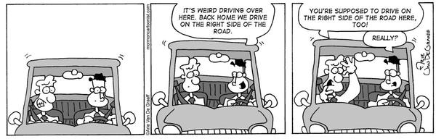
Many types of games
\\

Slide 9
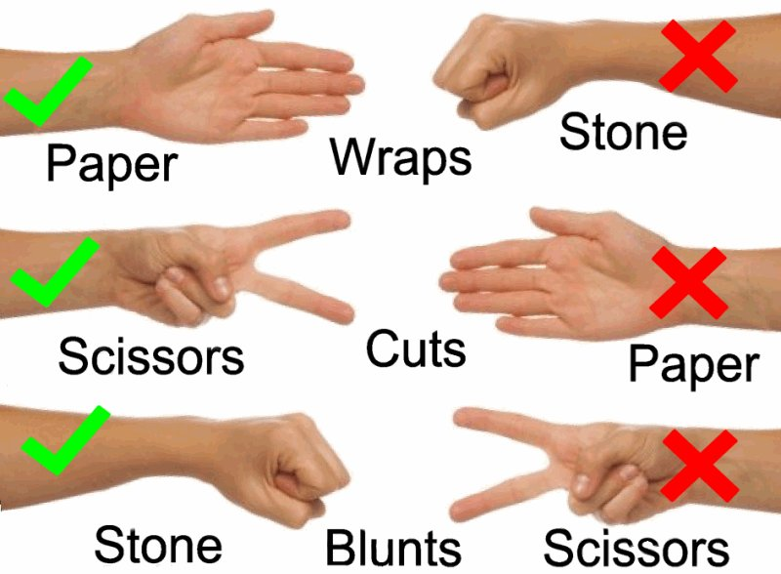
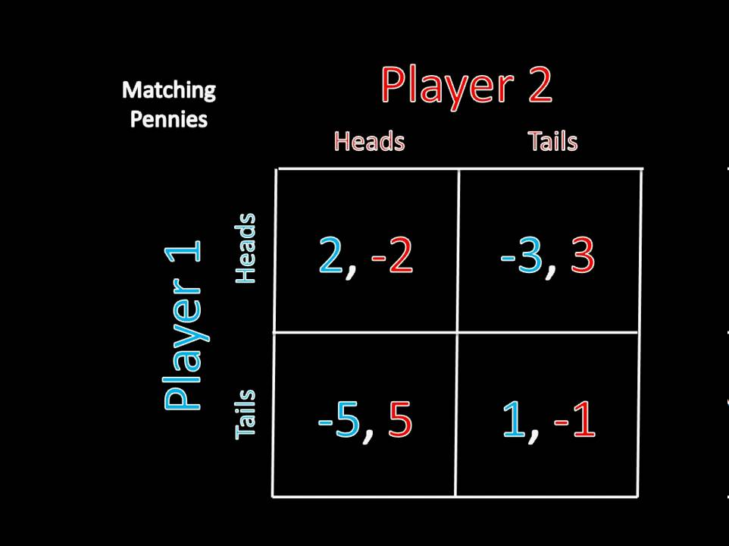
Many types of games
\\

Slide 10
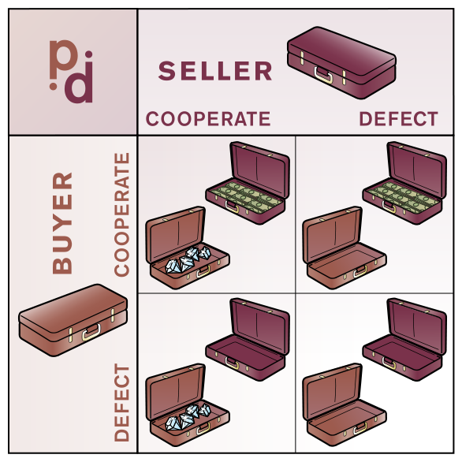
Repeated Games
Accountability
Now and later
Discount reward
Finite: Known and Unknown

Slide 11
A Brief History
200-500- Talmud
1713 – Minmax solution
1913 - Zermelo's Theorem
1944 - Theory of Games and Economic Behavior by John von Neumann and Oskar Morgenstern
Notes:
http://www.econ.canterbury.ac.nz/personal_pages/paul_walker/gt/hist.htm
http://www.law.yale.edu/documents/pdf/holler.pdf
Talmud discusses division of wealth between wives of deceased man if their marraige contracts differ as to the amount they are to recieve after his death.
1713 – first known minimax mixed strategy solution to a two-person game
Zermelo's Theorem- Chess, first “Theorem”
Nash – point at which there is not better strategy for any player given the strategies of the other players
Harsanyi – Randomness is really uncertainty

Slide 12
Minmax and Maxmin

Slide 13
A Brief History
200-500- Talmud
1713 – Minmax solution
1913 - Zermelo's Theorem
1944 - Theory of Games and Economic Behavior by John von Neumann and Oskar Morgenstern
1950-53 – Nash
Notes:
http://www.econ.canterbury.ac.nz/personal_pages/paul_walker/gt/hist.htm
http://www.law.yale.edu/documents/pdf/holler.pdf
Talmud discusses division of wealth between wives of deceased man if their marraige contracts differ as to the amount they are to recieve after his death.
1713 – first known minimax mixed strategy solution to a two-person game
Zermelo's Theorem- Chess, first “Theorem”
Nash – point at which there is not better strategy for any player given the strategies of the other players
Harsanyi – Randomness is really uncertainty

Slide 14
Nash Equilibrium
 | Cooperate | Defect
Cooperate | -1, -1 | -10, 0
Defect | 0, -10 | -5, -5

Slide 15
Nash Equilibrium
 | Cooperate | Defect
Cooperate | -1, -1 | -10, 0
Defect | 0, -10 | -5, -5

Slide 16
Nash Equilibriums
 | Left | Right
Left | 0, 0 | -10, -10
Right | -10, -10 | 0, 0

Slide 17
No Nash Equilibrium
 | Heads | Tails
Heads | 1, -1 | -1, 1
Tails | -1, 1 | 1, -1

Slide 18
A Brief History
200-500- Talmud
1713 – Minmax solution
1913 - Zermelo's Theorem
1944 - Theory of Games and Economic Behavior by John von Neumann and Oskar Morgenstern
1950-53 – Nash
1973 - Uncertainty
Notes:
http://www.econ.canterbury.ac.nz/personal_pages/paul_walker/gt/hist.htm
http://www.law.yale.edu/documents/pdf/holler.pdf
Talmud discusses division of wealth between wives of deceased man if their marraige contracts differ as to the amount they are to recieve after his death.
1713 – first known minimax mixed strategy solution to a two-person game
Zermelo's Theorem- Chess, first “Theorem”
Nash – point at which there is not better strategy for any player given the strategies of the other players
Harsanyi – Randomness is really uncertainty

Slide 19
Bayesian Games
This is different from simply imperfect information.
Imperfect information games: If, then
Bayesian Games: a little more complicated

Slide 20
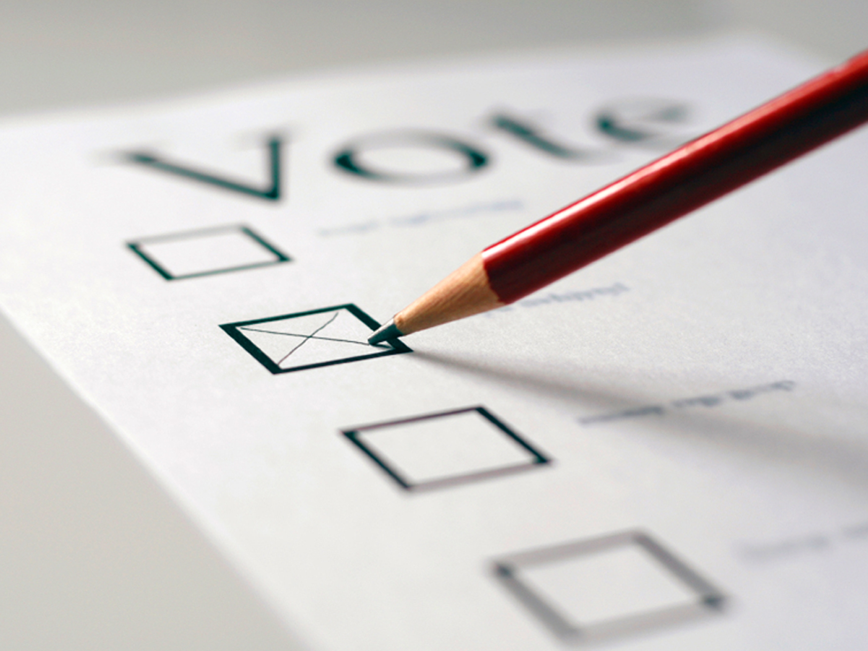
Voting

Slide 21
Types of Voting Systems
Plurality
Plurality with elimination
Borda
Pairwise elimination

Slide 22
Conditions for Elections
Pareto efficient
Independent of Irrelevant Alternatives
No Dictator
Notes:
Pareto Efficient

Slide 23
Arrow’s Theorem
There can be no system with more than two possible choices that holds with all of the fore mentioned conditions

